Slide 1
PROBLEM-SOLVING

Slide 2
How an agent can act by establishing goals and considering sequences of actions that might achieve those goals?
A goal and a set of means for achieving the goal is called a problem, and the process of exploring what the means can do is called search.

Slide 3
SOLVING PROBLEMS BY SEARCHING
Goal-based agent called a problem-solving agent decides what to do by finding sequences of actions that lead to desirable states.
Intelligent agents are supposed to act in such a way that the environment goes through a sequence of states that maximizes the performance measure.
Goal formulation (action of creating or preparing), based on the current situation, is the first step in problem solving.
Problem formulation is the process of deciding what actions and states to consider, and follows goal formulation.

Slide 4
An agent with several immediate options of unknown value can decide what to do by first examining ; different possible sequences of actions that lead to states of known value, and then choosing the best one.
This process of looking for such a sequence is called search. A search algorithm takes a problem as input and returns a solution in the form of an action sequence.
Once a solution is found, the actions it recommends can be carried out. This is called the execution phase.

Slide 5
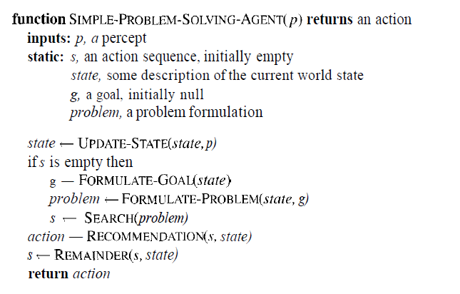
A simple problem-solving agent.

Slide 6
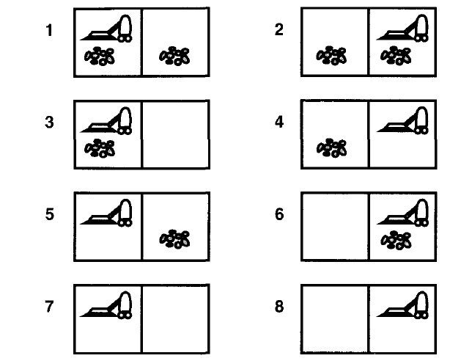
Eight possible states of the simplified vacuum world

Slide 7
FORMULATING PROBLEMS
Single-state problem- agent can calculate exactly which state it will be in after any sequence of actions.
For example, if initial state of vacuum cleaner is 5, then it can calculate that the action sequence [Right,Suck] will get to a goal state.
Multiple-state problem - when the world is not fully accessible, the agent must reason about sets of states that it might get to, rather than single states.
For example, in the extreme case, agent may have no sensors at all. In that case, it knows only that its initial state is one of the set {1,2,3,4,5,6,7,8}. Action Right will cause it to be in one of the states {2,4,6,8}. In fact, the agent can discover that the action sequence [Right,Suck,Left,Suck] is guaranteed to reach a goal state no matter what the start state.

Slide 8
Contingency problem- Agent does have a way to solve the problem starting from one of {1,3}: first suck, then move right, then suck only if there is dirt. Thus, solving this problem requires sensing during the execution phase.
Exploration problem- Consider an intelligent agent that has no information about the effects of its actions. The agent must experiment, gradually discovering what its actions do and what sorts of states exist. If agent survives, it has learnt the environment, which it can then use to solve subsequent problems.

Slide 9
Well-defined problems and solutions
A problem is a collection of information that the agent will use to decide what to do in order to reach the goal.
Elements of a problem definition are the states and actions which needs following:
Initial state of agent.
Set of possible actions available to the agent.
State space of the problem: the set of all states reachable from the initial state by any sequence of actions.
A path in the state space is simply any sequence of actions leading from one state to another.
The goal test, which the agent can apply to a single state description to determine if it is a goal state.
Path cost function is a function that assigns a cost to a path.

Slide 10
Measuring problem-solving performance
The effectiveness of a search can be measured in at least three ways.
First, does it find a solution at all?
Second, is it a good solution ?
Third, what is the search cost associated with the time and memory required to find a solution?

Slide 11
Examples
States, Operators, Goal test, Path cost
Toy problems (intended to illustrate or exercise various problem-solving method)
8-puzzIe problem
8-queens problem
Real-world problems (tend to be more difficult and whose solutions people actually care about.)
Route finding
Touring and travelling salesperson problems
Robot navigation

Slide 12
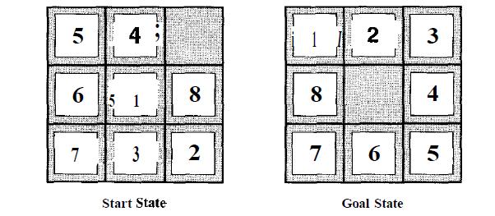
8-puzzle
Consists of a 3x3 board with eight numbered tiles and a blank space.
Tile adjacent to the blank space can slide into the space.

Slide 13
States: State description specifies the location of each of the eight tiles in one of the nine squares.
Operators: blank moves left, right, up, or down.
Goal test: state matches the goal configuration.
Path cost: each step costs 1, so the path cost is just the length of the path.

Slide 14
SEARCH STRATEGIES
Evaluation strategies :
Completeness: is the strategy guaranteed to find a solution when there is one?
Time complexity: how long does it take to find a solution?
Space complexity: how much memory does it need to perform the search?
Optimality: does the strategy find the highest-quality solution when there are several different solutions?

Slide 15
Uninformed search. The term means that they have no information about the number of steps or the path cost from the current state to the goal—all they can do is distinguish a goal state from a non-goal state.
Uninformed search is also sometimes called blind search.
Search strategies that have capability to choose the solution from available one are called informed search strategies or heuristic search.

